Slide 1
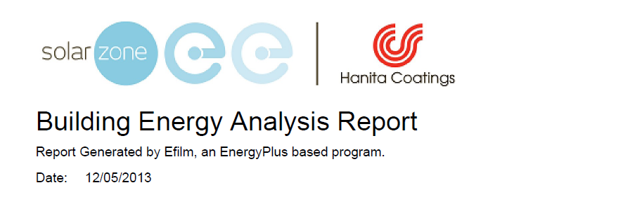
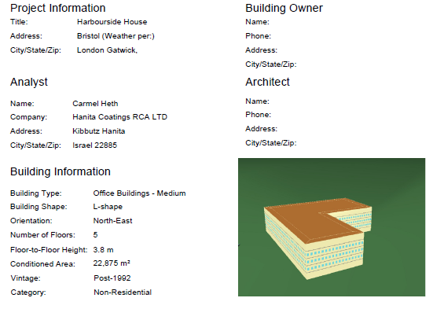
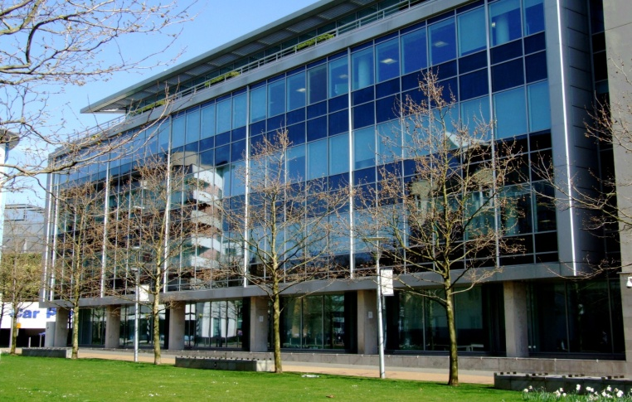

Slide 2
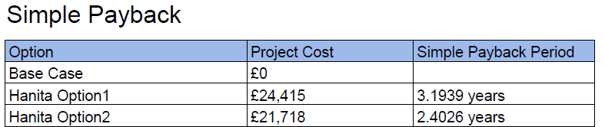

Executive Summary – In support of full Energyplus report 12/05/2013
Highlights
Potential annual energy savings kWh 83995 -147994
Potential annual energy savings at current costs £7762 - £13672
Potential annual Co2 Kg emission reduction 55674Kg – 98090Kg
Potential annual NOx Kg emission reduction 97Kg – 171Kg
Additional gas cost due to solar gain reduction in winter £820 -£1440
The above savings and costs assume that all things remain equal.
Cost of energy remains static over the next four years, In fact it is likely to rise speeding up payback times.
Building occupancy remains static and no new internal heat sources are introduced.
Heating and cooling regimes are able to respond to new lower levels of solar gain.
Internal layout of the building remains as it is at present. Dividing up internal spaces can alter airflow and increase cost of operation.
Benefits can only be fully realised if accurate metering is in place.

Slide 3
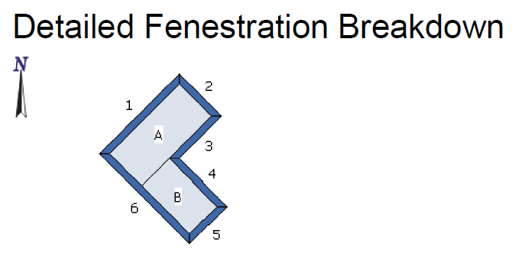
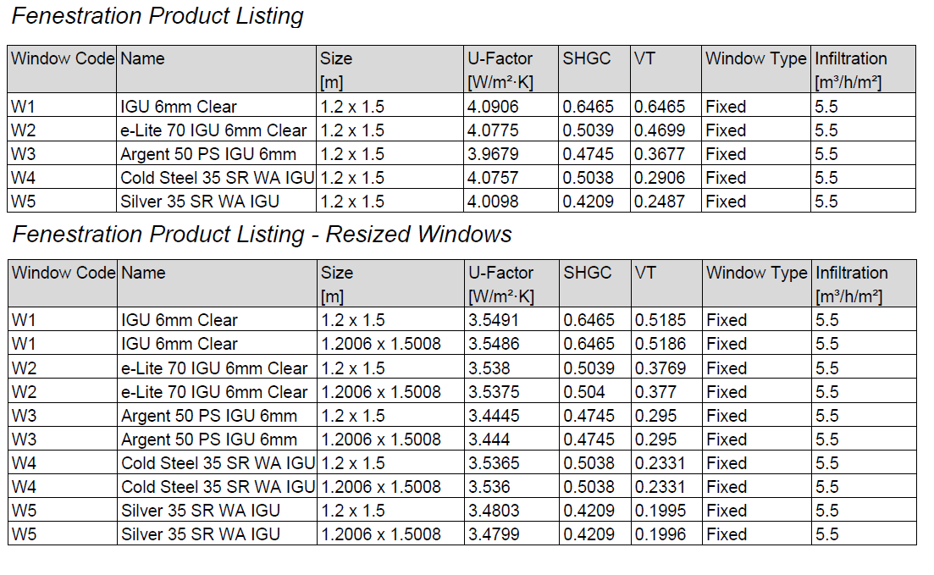
Dimensions
W1 (6) 85m
W2 (2) 40m
L1 (1) 75m
L2 (5) 35m

Slide 4
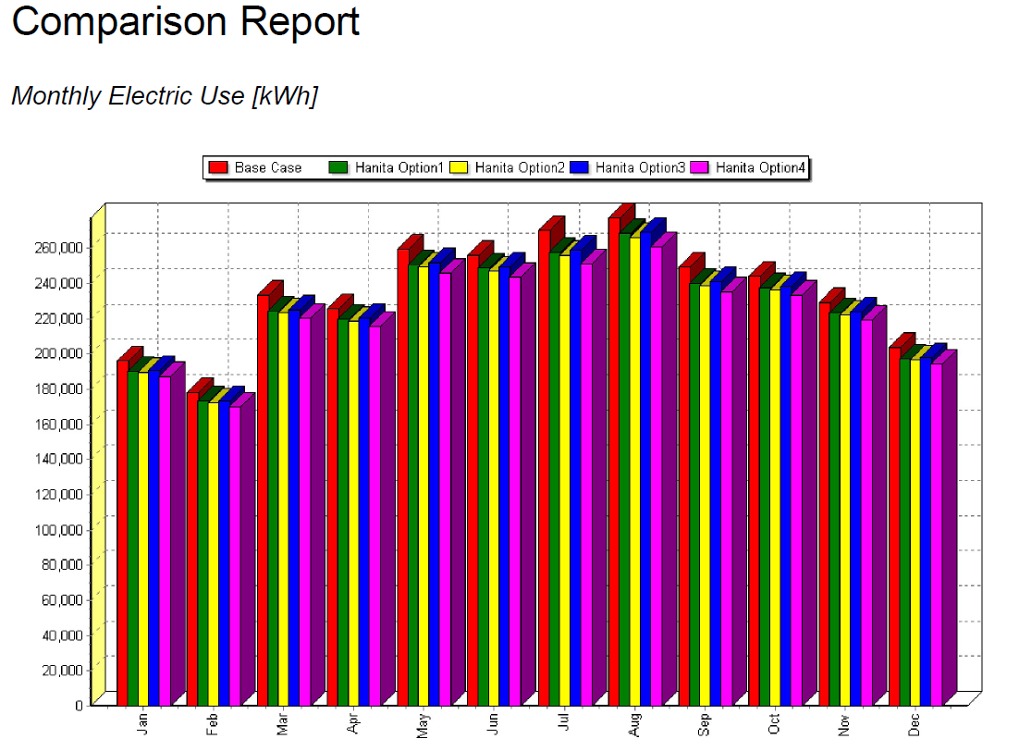
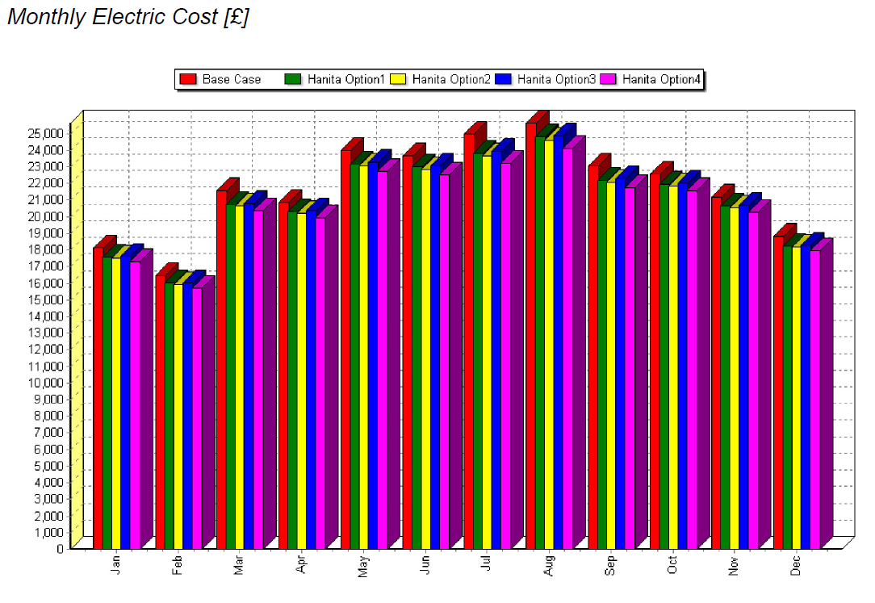
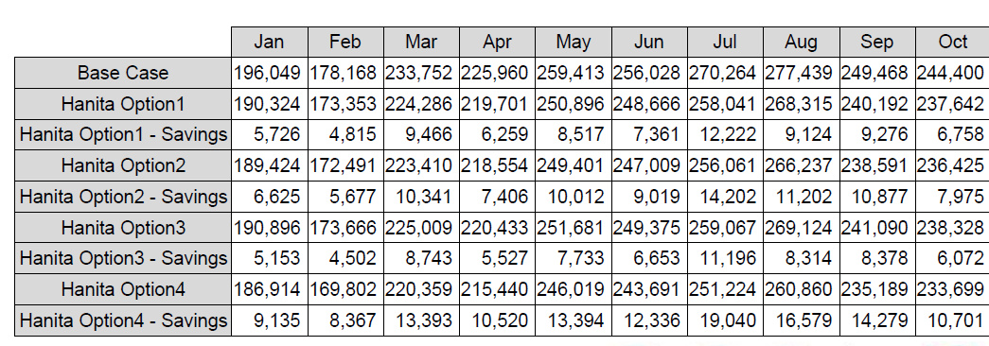
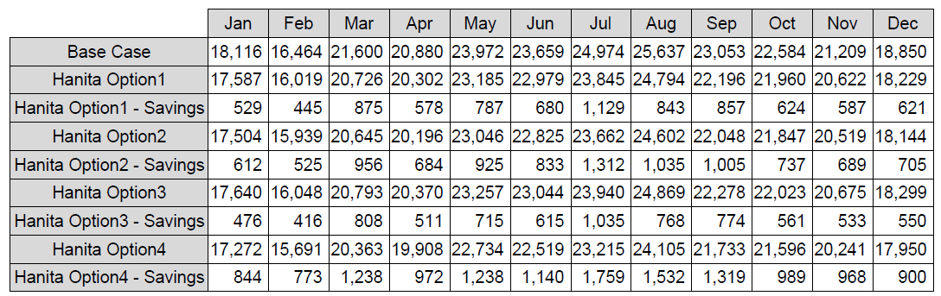
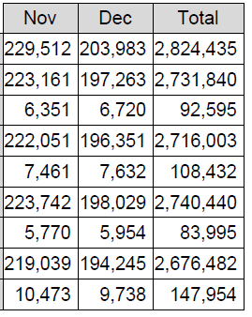
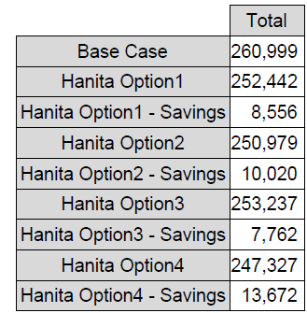

Slide 5
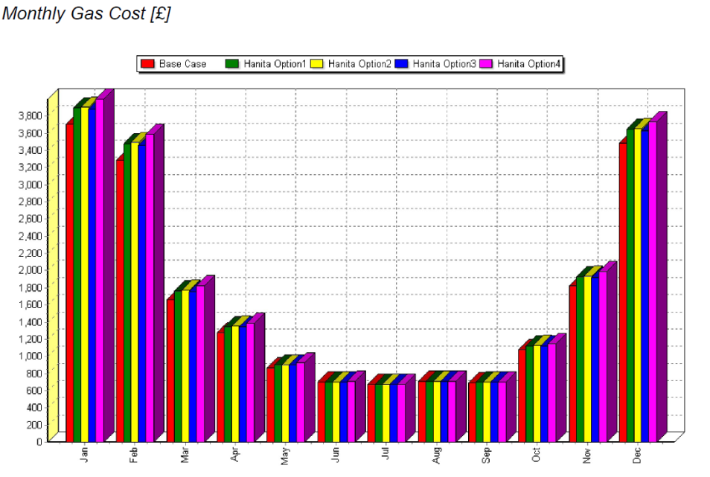
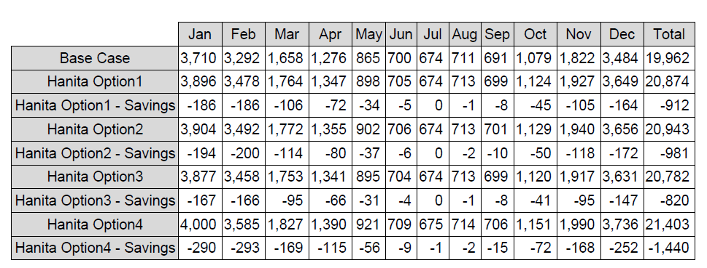
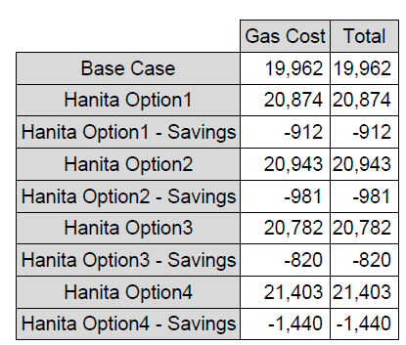

Slide 6
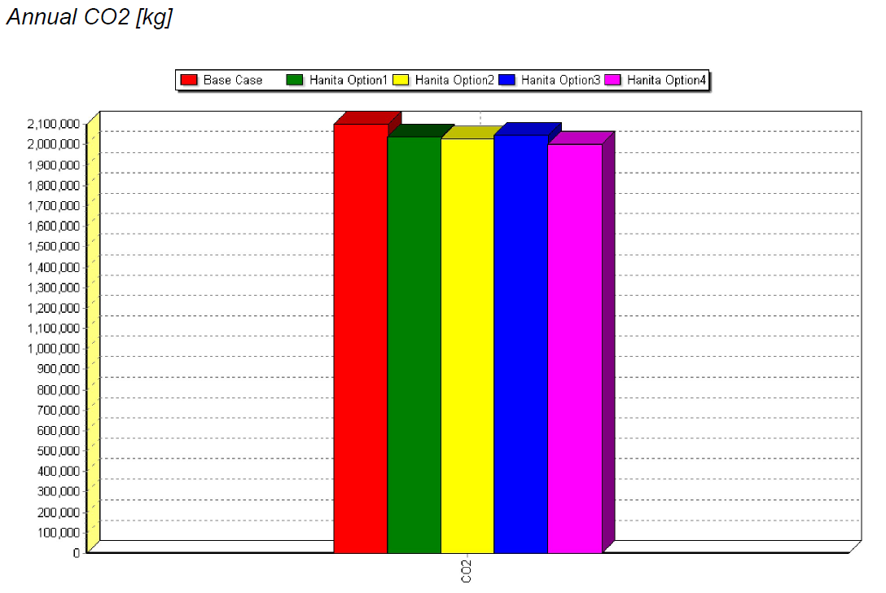

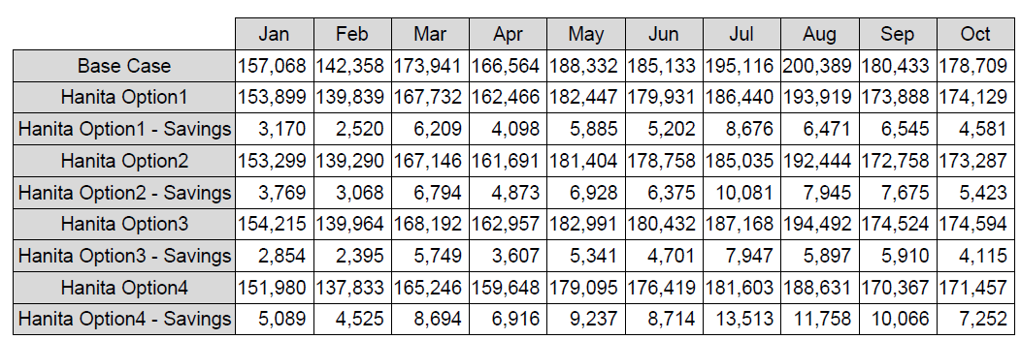
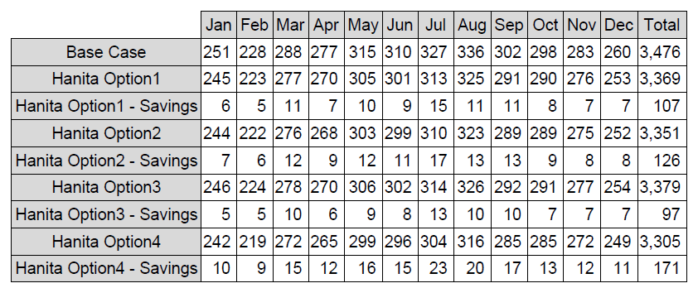
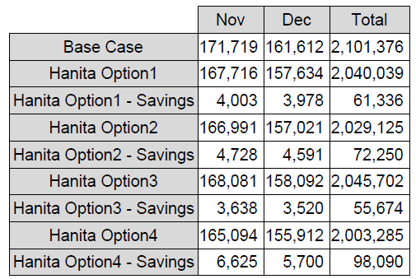
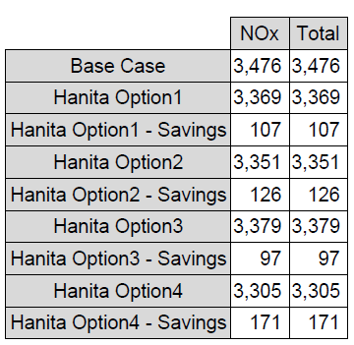

Slide 7
Efilm computer program is based on EnergyPlus simulation engine, which is developed under the
continuous funding of United States Department of Energy (U.S. DOE). EnergyPlus is considered
the most detailed and accurate energy simulation program on the market. EnergyPlus incorporates
the best features of DOE 2.1E and BLAST and is also enhanced with the use of latest programming
techniques and latest generation of FORTRAN compilers. The program has been thoroughly
tested and validated, and DOE is pledging full support only for the program developments in the
future. For more details and features of EnergyPlus can be accessed from:
http://apps1.eere.energy.gov/buildings/energyplus/energyplus_about.cfm
IWFA Efilm Disclaimer
Please be advised that the figures generated by Efilm regarding energy costs and potential energy
cost savings are only estimates. Actual results may vary, perhaps signficantly, depending upon,
among other things, changes in weather patterns, climate or topography, issues with a particular
building? s envelope, the efficiency of a building? s heating and cooling systems, and the type and
quality of film applied. The International Window Film Association and its members disclaim any
responsibility or liability for any damages or injuries, financial or otherwise, that may be claimed to
arise from the accuracy or inaccuracy of the estimates calculated by the Efilm software.

